Slide 1
Research Topic : A Comparison Architecture of AMD Ryzen 5 3600X And Intel Core i5-9600K
Course Code – CSE-0410
Course Title : Parrral Processing And Distributed System
Rubyat Jesmin Shammi UG02-47-18-034
Khondkar Md. Mufrat Tasif UG02-47-18-044
Ahasanul Bari Rifat UG02-47-18-007

Slide 2

Topic we discussed
What is Processor ?
AMD Ryzen 5 3600X & Intel Core i5- 9600K Processor
Proposed Methodology
Problem Statement & Comparison Measures
Motivation ,Scopes & Limitations

Slide 3
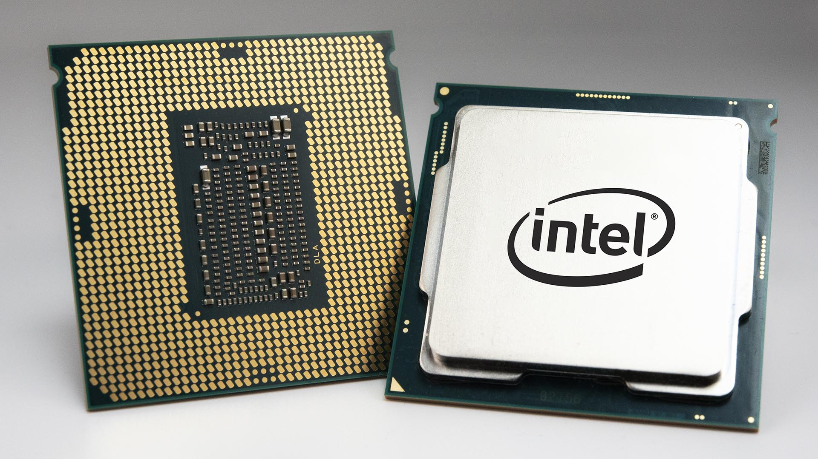
Processor is a logic circuit that’s responds to and process the basic instruction that drive a computer. Without a processor computers couldn’t run any type of program. It’s performs logical, input/output and others basic instructions that are passed from an operating system.
What is Processor ?

Slide 4
AMD Ryzen 5 3600X & Intel Core i5- 9600K Processor
AMD Ryzen 5 3600X : Here, third-generation Ryzen 5 chips based on AMD latest Zen micro architecture about Ryzen 5 3600X. This one is few good features have been added to this version than the previous one. Intel Core i5-9600K : Here, It is a 64-bit Hexes-core mid-range performance x86 desktop micro processor introduced by Intel in late 2018. This chips has dual channel of max 128 GB of size that’s support DDR4-2666 bus speed.

Slide 5
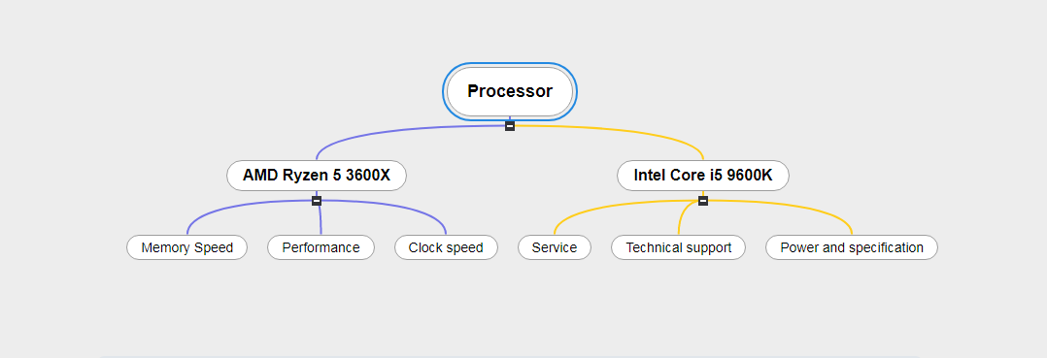
Proposed Methodology

Slide 6
Is parallel processing and distributed system is properly incorporated in AMD Ryzen 5 3600X and Intel Core i5-9600K? In future, we was research about it and find out problem solutions.
Problem Statement
Comparison Measures:
1. Clock speed 2. Performance 3. CPU 4. Power 5. Memory support

Slide 7
AMD Ryzen 5 processor are good & effective for gaming & multi-tasking. That's why we have interested to work with this. On the other hand, Intel core i5-9600K is already used for office work & daily uses. For this reason We are working with this.
Motivation
Scopes And Limitation
Scopes: 1. We can find out which one is more better in daily life . 2. We can detect the area of upgrade and improve. Limitation: We can only find out which parts will difference between of them . So this comparison will not be 100% accurate. It is depends on the comparison measures topic.

Slide 8
Literature Review &
Primary Finding

Slide 9
Topic we discussed
Literature Review :
Existing scholarly work on the topic (Review Topic name)
Existing scholarly work on the topic (Review Reference)
Area of Focus
Primary Finding :
AMD Ryzen 5 3600X
Intel Core i5-9600K

Slide 10
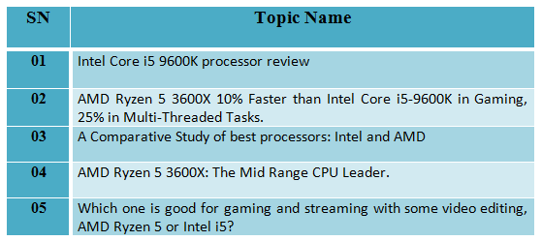
Existing scholarly work on the topic (Review Topic Name)

Slide 11
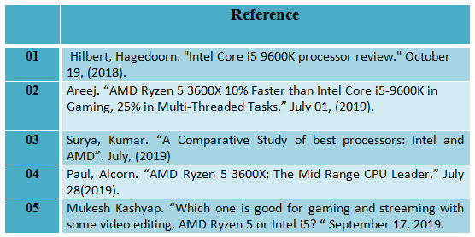
Existing scholarly work on the topic (Review Reference)

Slide 12
Area of Focus
Our areas of focus are :
Gaming and video editing
For workstation
Heavy software uses
Performance think about price

Slide 13
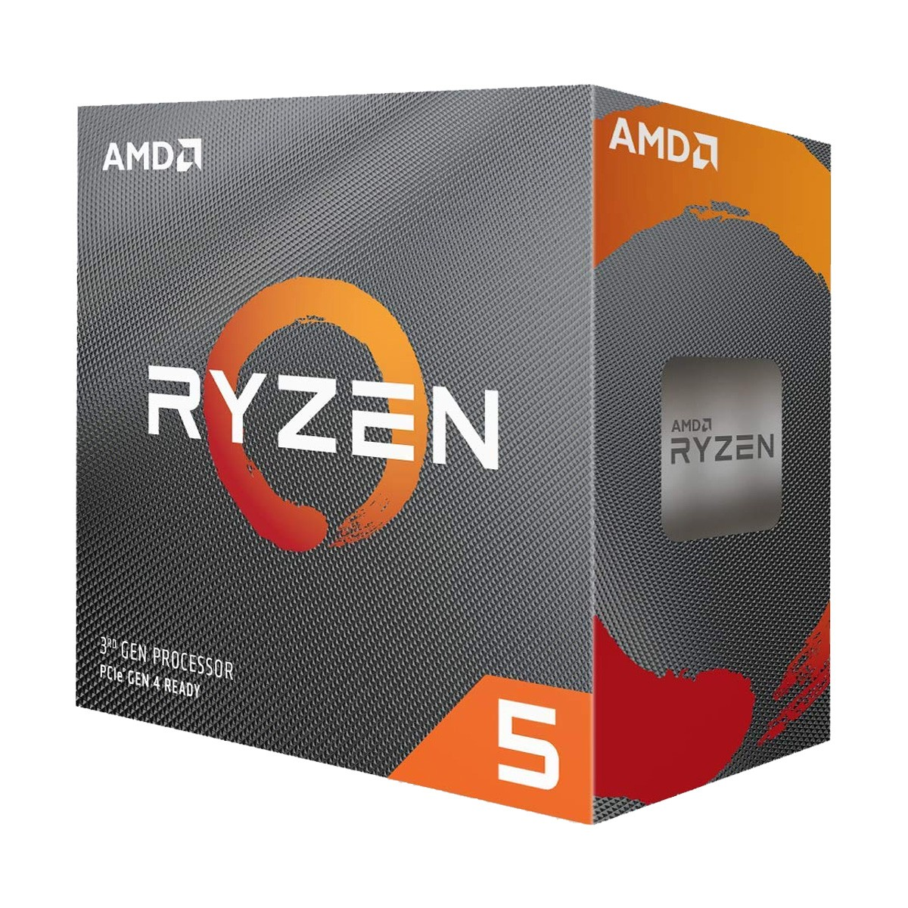
AMD Ryzen 5 3600X
The AMD Ryzen 5 3600x is a bags of performance in mid-range package and AM4 processor launched in 2019
AMD Ryzen 5 3600X Which is the Zen 2 micro architecture .
32 MB L3 cache with operated 3.8 GHz .
It has a base clock speed of 3.8 GHz to max clock speed of 4.4 GHz.
This processor has a 95W TDP ( Thermal Design Power) .
It has 6 cores and 12 threads and unlocked a wraith spire cooler.

Slide 14
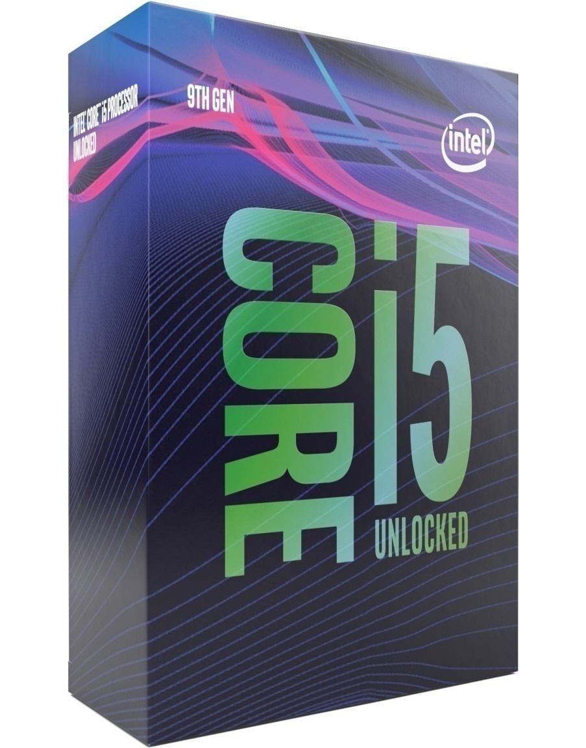
Intel Core i5-9600K
Intel Core i5-9600K 9th Generation is Socket LGA1151 Unlocked Desktop Processor launched in 2018.
The Core i5-9600K, which is based on the Coffee Lake micro architecture.
9 MB L3 cache with operated 3.7 GHz .
This processor has a 95W TDP ( Thermal Design Power) .
It has 6 cores and 6 threads and unlocked a wraith spire cooler.
Highest supported memory is DDR4 2666 Mhz.

Slide 15
Final Research Review

Slide 16
Topic we discuss
Better For Multi-tasking
Basic Difference Between AMD & Intel
For Gaming Which is Better?
AMD vs. Intel ( Performance, CPU & Clock Speed )
AMD vs. Intel (Memory Support & Technical Support)
Comparison Based Result
Conclusion

Slide 17
Better For multi-tasking
The core i5-9600K hold magnetically in multitasking and workloads. This processor also generally better in heavy software uses and loads and sometime it better in editing.
So, we can see this Ryzen series CPU much better in multi-tasking , taking overloads, video editing and streaming. The 3rd Gen Ryzen 5 CPUs basically murder the Core i5-9600K in productivity and content creation related multitask loaded and it beat Intel.

Slide 18
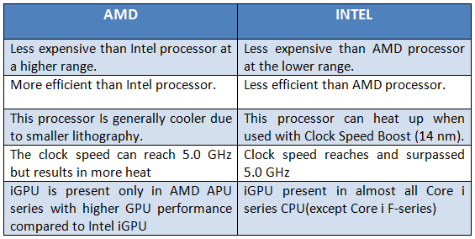
Basic Difference Between AMD & Intel

Slide 19

For Gaming Which is Better ?
If we think about Intel core i5-9600K to compared in gaming position then Intel is coming out on top but just only (if you have more capable graphics card or SSD card ).
In other side AMD Ryzen 5, for the productivity and gaming performance (gaming or multitasking) it’s a fantastic processor. The 3600X with its higher boost clock is suited for gaming-centric workloads. This processing beat Intel core i5-9600K.

Slide 20
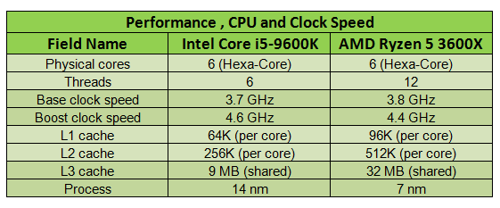
AMD vs. Intel ( Performance, CPU & Clock Speed )
Core i5-9600K and Ryzen 5 3600X basic parameters such as number of cores, number of threads, base frequency and turbo boost clock, process, cache size and multiplier lock state. These parameters indirectly say of CPU and Clock speed and also performance.

Slide 21
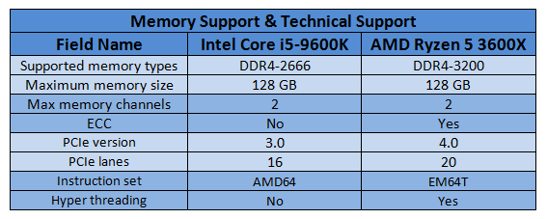
AMD vs. Intel (Memory Support & Technical Support)
These are memory standards supported by CPUs. The higher such standards, the better a CPU’s performance. Depending on the motherboards, higher memory frequencies are memory supported.

Slide 22
Comparison Based Result
Both the Ryzen 5 3600X 6-Core 3.8GHz and the Core i5-9600K 6-Core 3.7GHz were released at the same time, so are likely to be quite similar. When compared against the Intel Core i5-9600K, it's head-to-head with Intel coming out on top .
If we should about performance (threads and clock speed) The Ryzen 5 3600X beats the Core i5-9600K as a result of having twice the threads and a considerable amount of L3 cache. The Core i5-9600K often catches the Ryzen 5 3600X when it is over clocked to 5 GHz on all its cores.
If we think about buying then, the Ryzen 5 3600X has about 50% better overall (multi core) performance, but the core i5–9600K has slightly better single-core performance in most cases, so for things like gaming or video editing, the 3600X is still likely to be a better option in the long run.

Slide 23
Conclusion
When using a CPU, our concerns are broadly cut along the lines of having a speedy computer, that enables the smooth operations of your rendering and creating needs.
Therefore, this CPUs must have plenty of cores, and threads. We can not choosing between AMD and Intel is much harder. Luckily, you don’t necessarily have to choose one over the other. Both have their own strengths and weaknesses, as well as excellent CPUs on offer catering to every need and budget.
In terms of price, over clocking abilities, graphics, and component variety. Overall in streaming, video editing, gaming, and multitasking AMD Ryzen 5 3600X is better. Other side, you can also choose Intel i5-9600K for gaming, streaming. That way, you can choose wisely , It’s all about to you.

Slide 24


